Slide 1


NO-SHOW NAVIGATION – Phase 3: Development
November 14th, 2023
Rishika Rachel Manda, M.S. in Data Science
Practical Data Science, CS 667
rm74565n@pace.edu
Pace University, NYC
1

Slide 2
AGENDA
Executive Summary
Project plan recap
Data
Exploratory data analysis (EDA)
Modelling methods
Findings
Recommendations and next steps
2

Slide 3
EXECUTIVE SUMMARY
A hospital is facing issues with patients not showing up for their scheduled appointments. The no-shows are causing scheduling issues and financial losses.
Identify patterns and factors contributing to patients missing their appointments. Predict whether a patient will show up for their appointment.
3

Slide 4
PROJECT PLAN RECAP
Deliverable | Details | Due Date | Status
Data & EDA | Identify patterns and factors contributing to patients missing their appointments. | 10/31/23 | Complete
Methods, Findings, and Recommendations | Modeling: Outcome variable, features, model type Findings: Understanding the insights | 11/14/23 | Complete
Final presentation | Final completed deck | 11/21/23 | In Progress
4

Slide 5
DATA
5

Slide 6
DATA
Data source: Kaggle, Sample size: (110527 rows, 14 columns), Time period: 2016
Data alterations:
Introduced new feature called ‘Waiting Time’ in order to understand the impact/contribution of the time patients had to wait until the Appointment day.
Excluded rows with negative ‘Waiting Time’ values.
Assumptions:
Anomalies/errors in ‘Appointment day’ entries, specifically time-based.
Extensive study showed certain neighbourhoods where scholarships (financial aid) were given. Data was extracted from Brazil when Brazilian government offered scholarships for poor families (‘Scholarship’ is one of our features) under the program ‘Bolsa Familia’. Here’s the link for additional information Bolsa Familia program
6

Slide 7
EXPLORATORY DATA ANALYSIS
7

Slide 8
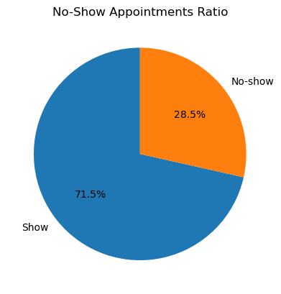
No-shows in different neighbourhoods
The ‘No-show’ ratio overall is 28.5% and one of the first features to explore was ‘Neighbourhood’.
The locality ‘JARDIM CAMBURI’ was found to be the one with the highest number of No-Shows among all the neighbourhoods.
It was found that the scholarships were probably not given to the majority of people in this particular neighbourhood, and this proved to be one of the major factors contributing towards No-Show’.
8

Slide 9
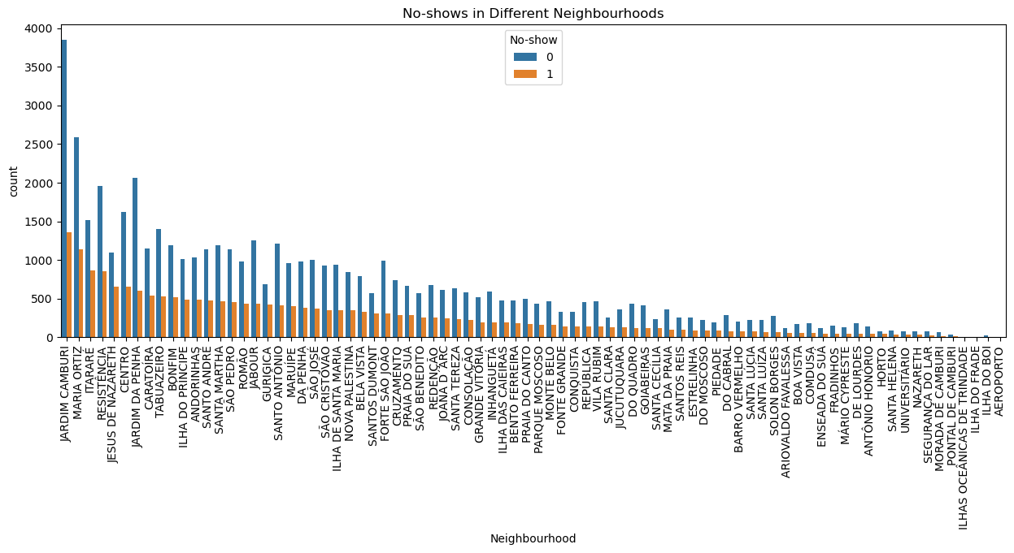
No-shows in different neighbourhoods - Chart
9

Slide 10
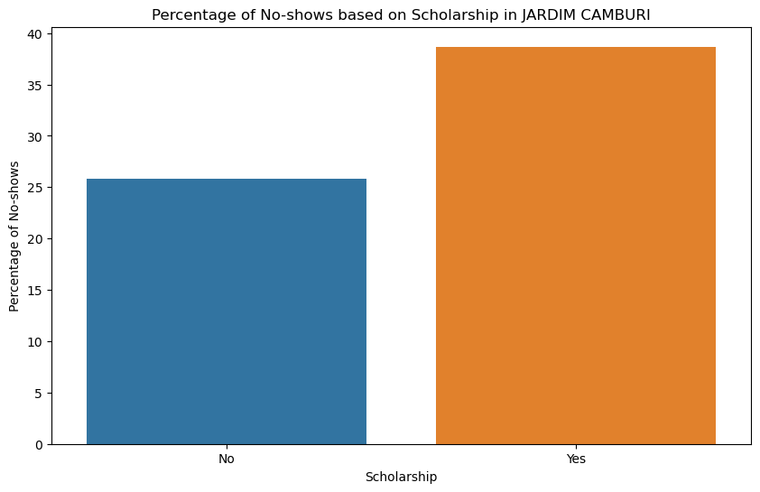
Scholarships in Jardim Camburi
More than 25% of the people in Jardim Camburi were not given/didn’t enroll for the scholarships.
Out of this 25%, there is a large proportion of ‘No-Shows’
Hence, it is evident that scholarships can be the one of the factors that impact ‘No-Shows’. (Hypothesis 1)
10

Slide 11
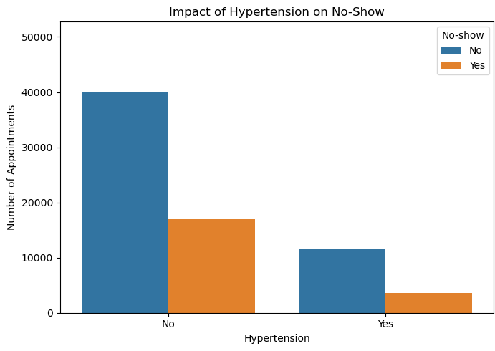
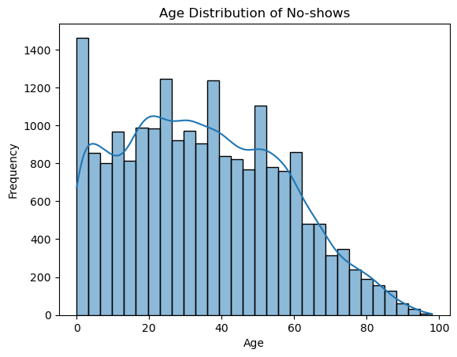
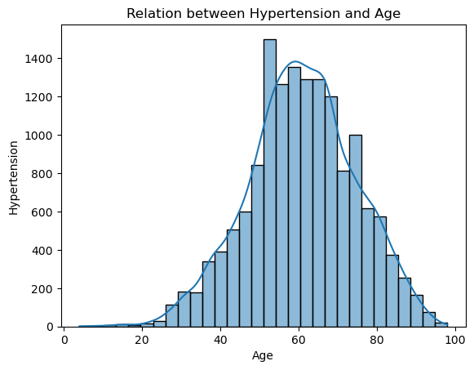
No-shows based on hypertension and age
The features ‘Hypertension’ and ‘Age’ appeared to be strongly co-related with the number of No-shows as per the plots.
There may exist a relationship between these two features contributing to the patients not showing up on their scheduled days of appointments. (Hypothesis 2)
Evidently, the people between ages 50 and 80 suffer from hypertension. This relationship can substantially prove to be one of the factors leading to No-shows.
11

Slide 12
MODELING METHODS
12

Slide 13
Modeling methods
Outcome Variable: Will patients show up? Our goal is to predict whether a patient will attend their scheduled medical appointment. This helps us in better scheduling and resource management, ensuring efficient healthcare delivery.
Features:
We consider the patient's appointment history, demographic details (age, gender), appointment-related information (time of day, day of the week), Hypertension, Diabetes and SMS received.
These features provide insights into patient behaviour and help us understand patterns related to appointment attendance.
Model type: Random Forest
Random forest is like asking a group of experts where each expert gives their opinion, and the most popular opinion is chosen. It makes our model robust and less prone to errors from any source.
Random Forest can handle complex interactions between features and operates by constructing multiple decision trees.
13

Slide 14
Modeling methods (continued)
Model type: Random Forest
Balanced Decision Making: In healthcare, it's crucial not to be overly biased by a single factor. Random Forest naturally avoids getting overly influenced by just one aspect of the data.
Adaptable to Different Patients: Just like every patient is different, Random Forest adapts to the varied characteristics of patients, like age, gender, and appointment history.
Combining multiple factors and learning from patterns from individual decision trees to generate a strong prediction.
Model type: Random Forest (Technical version)
Reference in the appendix
14

Slide 15
FINDINGS
15

Slide 16
Our Insights: How well can we predict No-shows?
Understanding our insights:
1. Overall, Success Rate: About 63% Accuracy
What This Means: Our model correctly predicts whether patients will show up for their appointments about 63% of the time.
2. Precision and Recall: A closer look
For Patients Showing Up (Class 0):
Precision (75%): When our model predicts a patient will show up, it's correct 75% of the time.
Recall (73%): Of the patients who show up, our model correctly identifies 73% of them.
For Patients Not Showing Up (Class 1):
Precision (36%): When our model predicts a no-show, it's correct about 36% of the time.
Recall (37%): Our model identifies 37% of the patients who won't show up.
What This Tells Us: We're better at predicting who will show up than who won't. This finding is crucial for planning and managing our healthcare resources effectively.
16

Slide 17
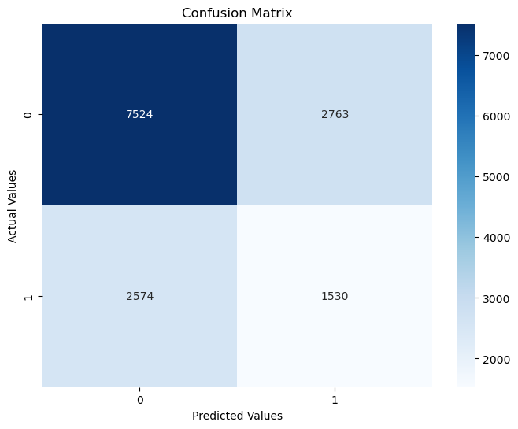
Our Insights (continued)
3. Confusion Matrix: Understanding Our Predictions
Interpreting the Numbers:
Out of 10,287 patients expected to show up, we correctly predicted 7,524 but mistakenly thought 2,763 wouldn’t show up.
For the 4,104 patients not expected to show up, we correctly identified 1,530, but we missed 2,574.
Impact: It shows where we need to improve, especially in identifying patients who might miss their appointments.
17

Slide 18
RECOMMENDATIONS & NEXT STEPS
18

Slide 19
Recommendations & Next steps
Recommendations – Turning insights into actions
Key Findings:
Our model is better than random guessing but needs improvement in predicting no-shows.
The model has low precision for no-show predictions, which means it is only correct about 36% of the time when it predicts a no-show.
Connection to the Business need:
Accurately predicting no-shows is crucial for better scheduling and resource allocation in our healthcare services.
Incorrectly predicting no-shows can lead to underutilization of resources and missed opportunities to serve more patients.
Actionable Recommendation:
Develop targeted strategies to engage with patients flagged as potential no-shows, including reminder systems, flexible rescheduling options, or transportation support to encourage attendance.
19

Slide 20
Recommendations & Next steps (continued)
Next Steps – Advancing the predictive capabilities
1. Building a more advanced model:
Objective: To improve the accuracy and reliability of our predictions.
Approach: Explore more sophisticated machine learning techniques, like ensemble methods or deep learning, that could more effectively capture complex patterns in patient behaviour.
2. Expanding data collection:
Objective: To gain a more comprehensive understanding of factors influencing patient no-shows.
Approach: Collect additional data such as socio-economic factors, weather conditions on the appointment day, or patient satisfaction with previous visits.
3. Continuous monitoring & updating:
Ongoing Task: Regularly evaluate the model's performance with current data.
Purpose: To ensure the model adapts to changing patterns in patient behaviour and remains effective over time.
20

Slide 21
APPENDIX
21

Slide 22
Additional Information
Modeling Methods:
1. Model type: Random Forest (Technical version)
Rationale: .In our dataset, the relationship between features (like patient demographics, appointment history, and time factors) and the outcome (patient no-shows) is intricate. Random Forest can handle complex interactions between features and robustness against overfitting.
Theoretical Background: It operates by constructing multiple decision trees during training and outputting the mode of the classes (classification) for individual trees. It mitigates the risk of error in particular trees and provides a more accurate and stable prediction.
Hyperparameter Tuning: Parameters like n_estimators, max_depth, min_samples_split, and the tuning approach (GridSearchCV) applied.
Git Repo: https://github.com/Rachel2302
22

